Slide 1
Exo Actuator
Team Exo:
Alexander Frieden, Chancelor Cuddeback, Callum Fisher, Abdulrahman Alshammari, and Joshua Davidson

Slide 2
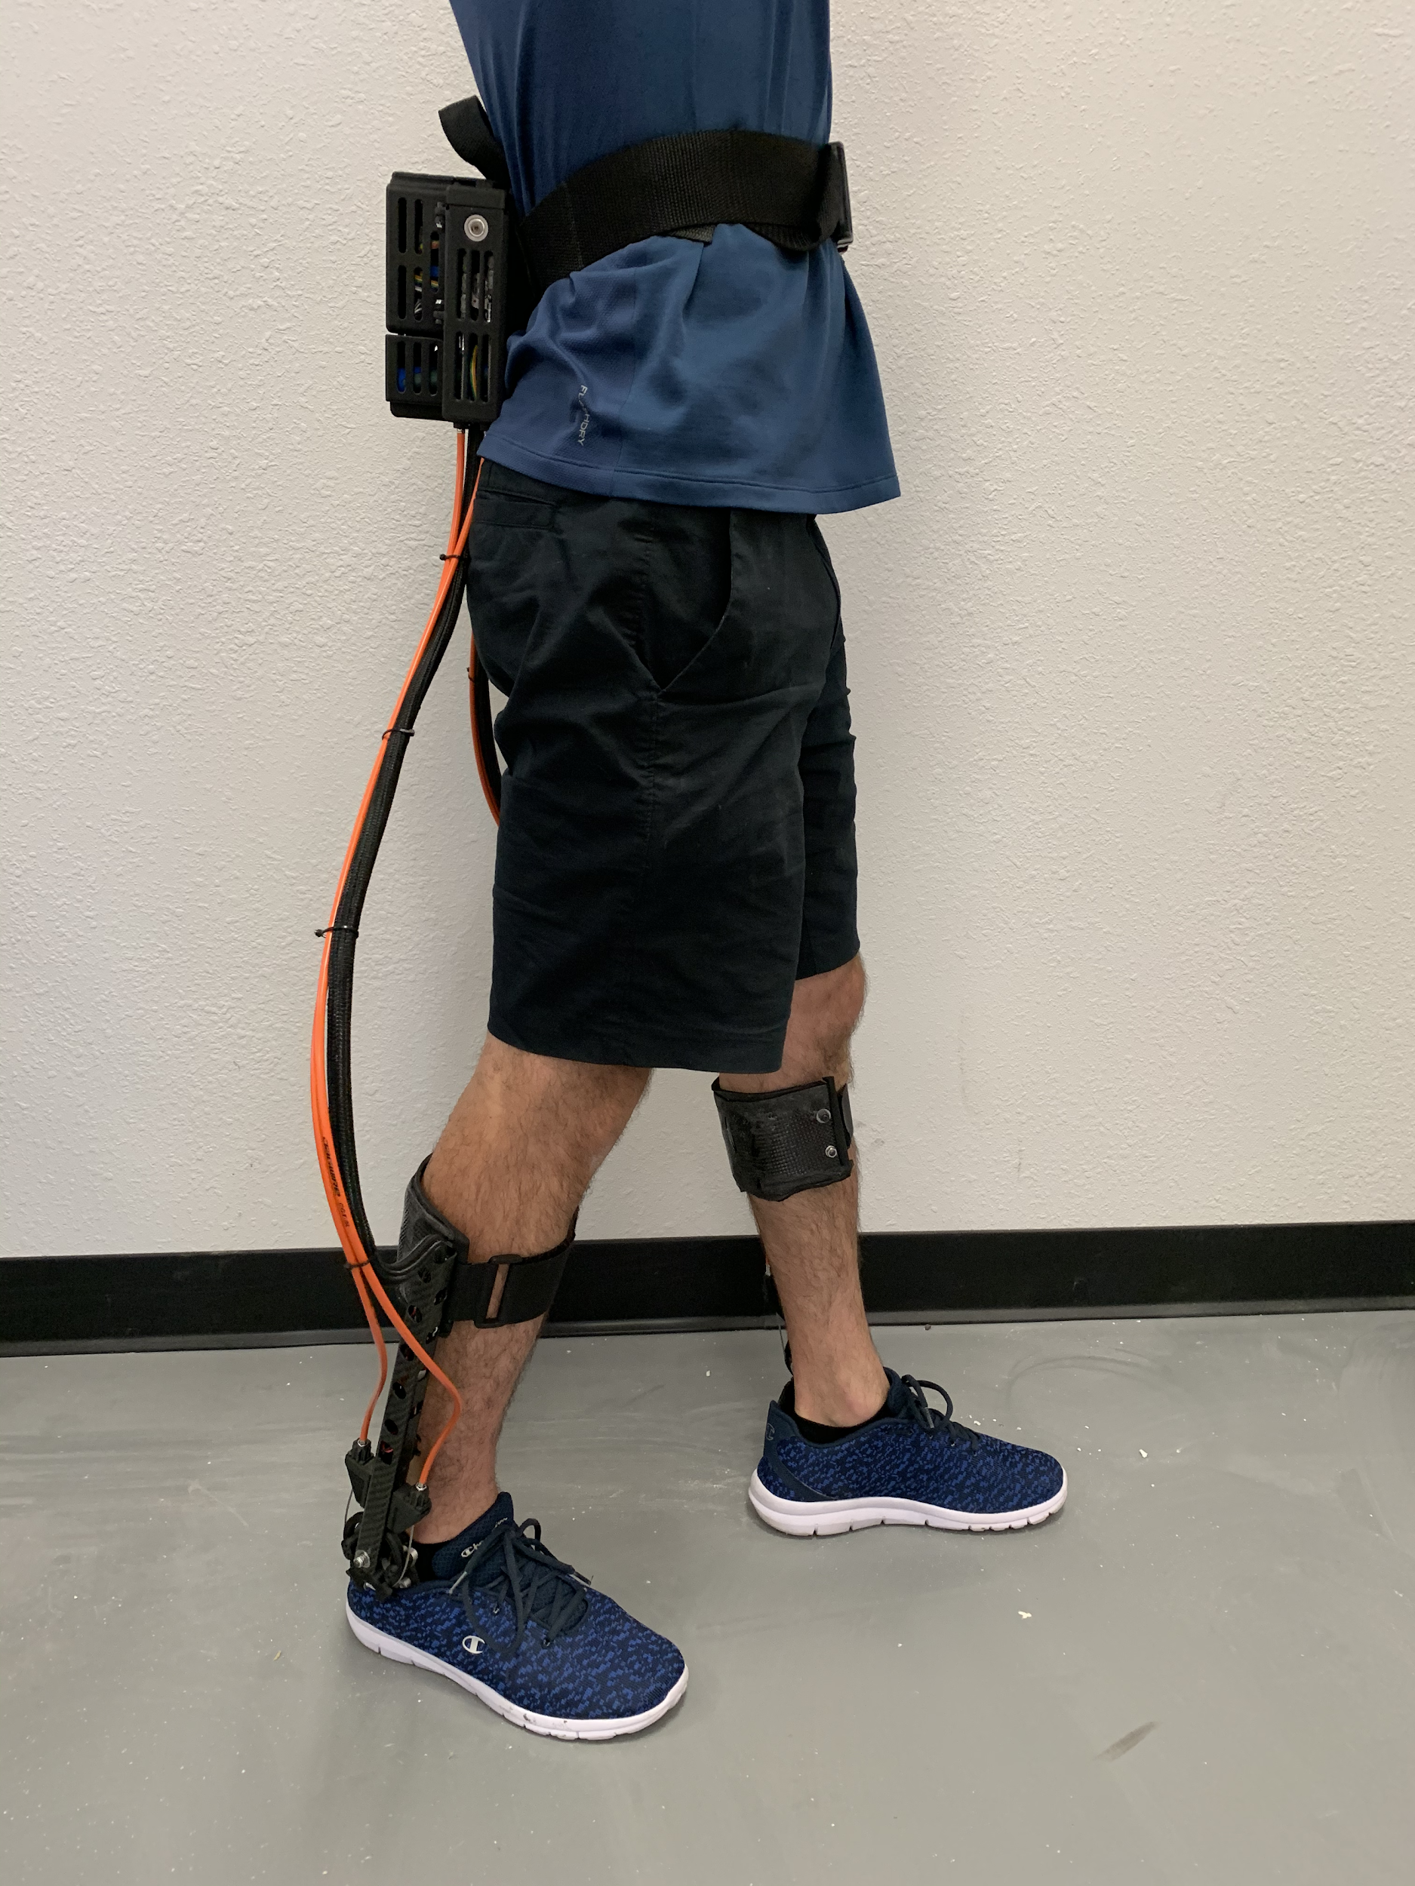

Overview
Design Description
Customer Requirements
CAD Models: Old and New
Code
Testing
Budget
Project Plan

Slide 3
Customer Requirements
The customer asked that the team:
Make a testing bench
Construct a program that will test and control the AK80-9KV100 motor
Stay within $3,000
The client has made it clear that controlling the motor is the main priority, and that any additional tasks will be included only if time permits

Slide 4
Engineering Requirements
With the current focus being on controlling the motor, the engineering requirements are limited, as the scope is quite narrow
Controller using CAN 2.0 and Serial UART protocols
Code running on a Arduino nano 33 ble
Test position, torque, and angular velocity
Mount motor to frame

Slide 5
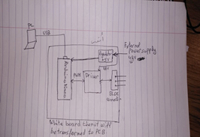

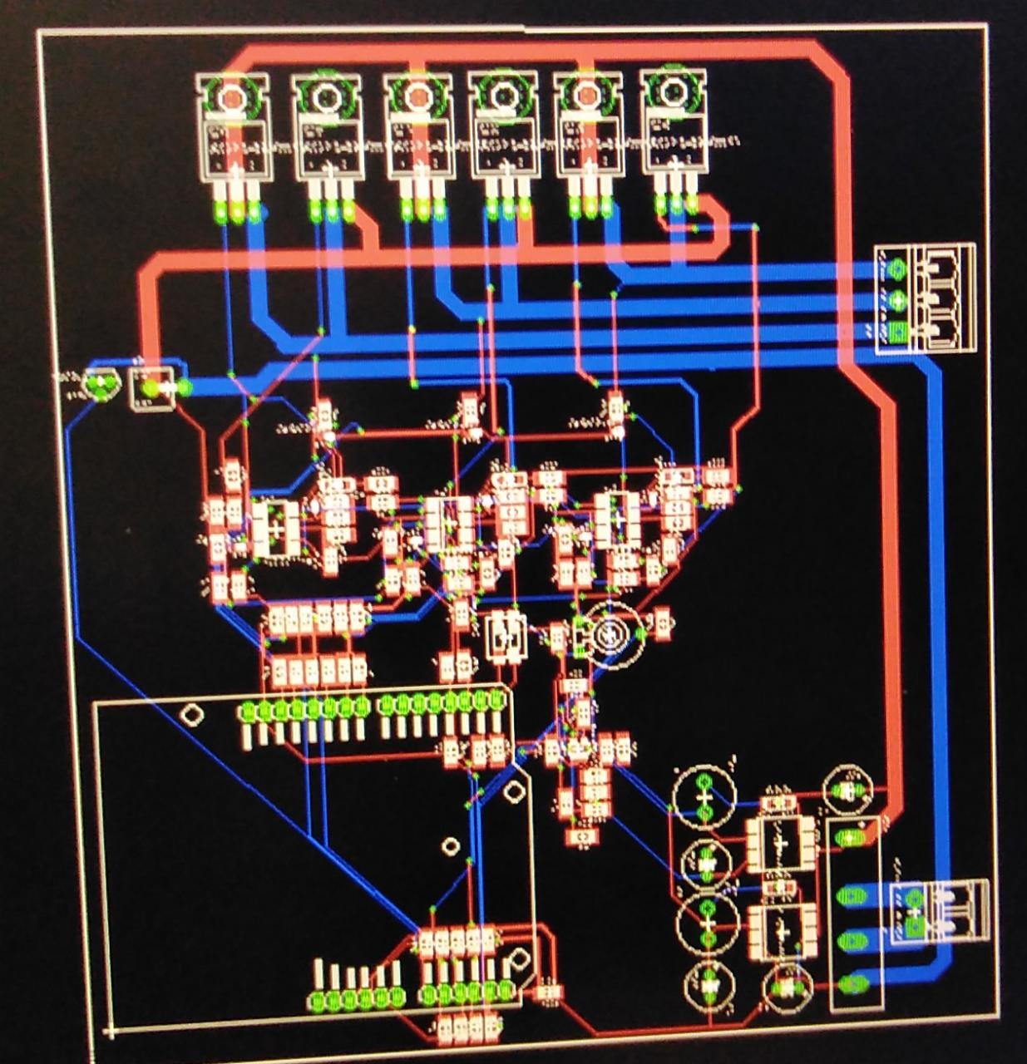
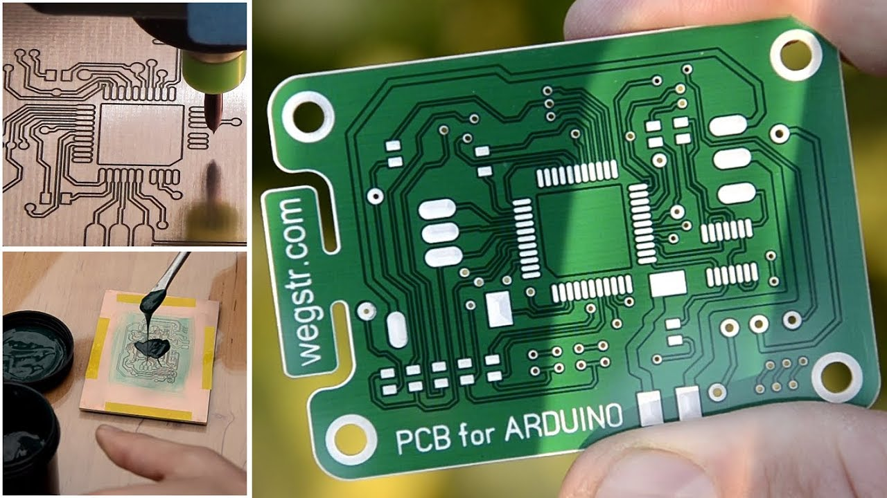
PCB Design
PCB Definition
Sketches
Eagle Program
95% is done
Green Board
120 Components

Slide 6
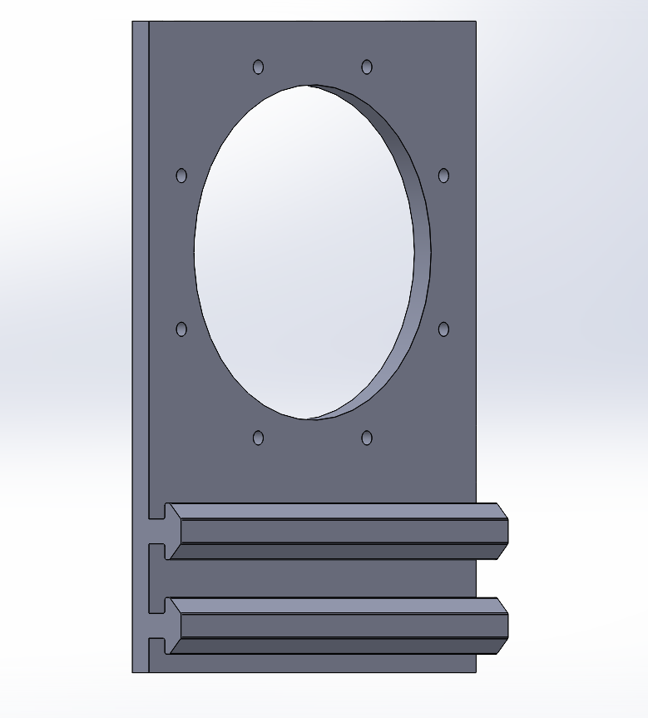
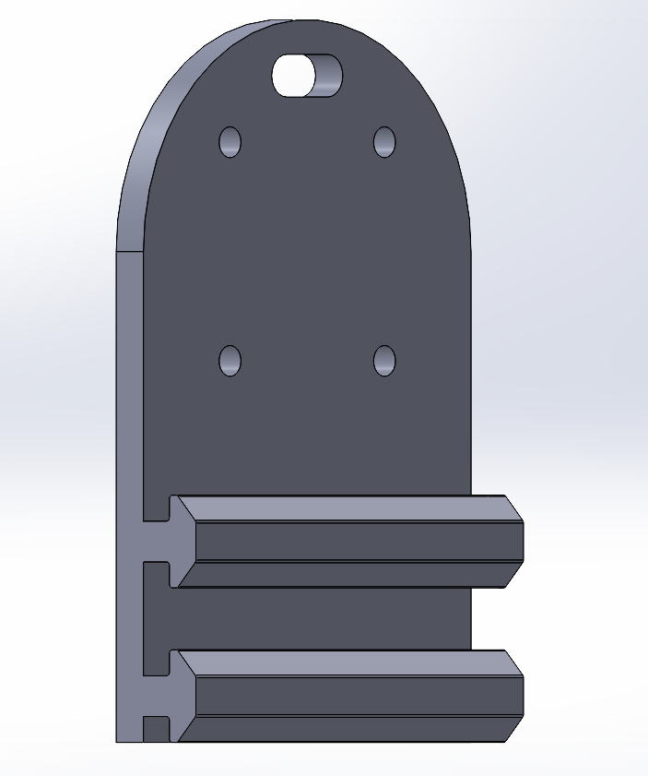
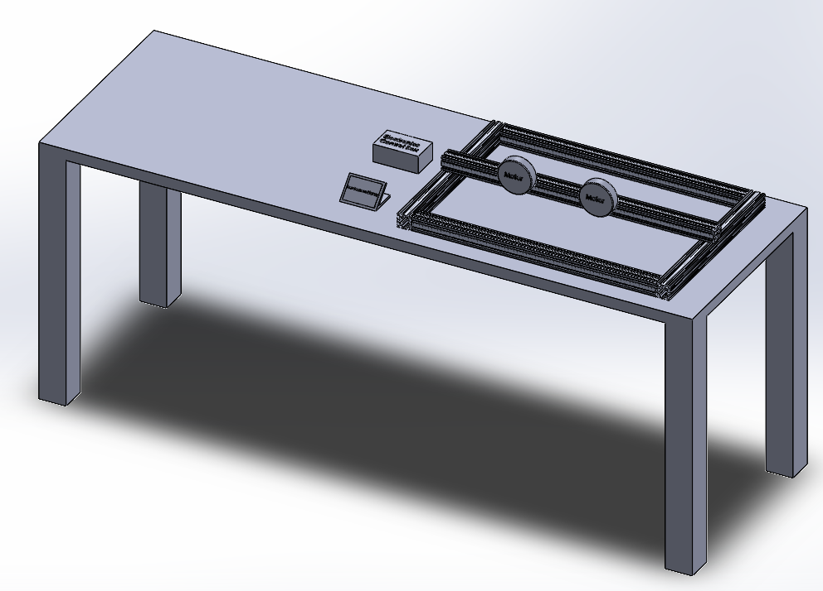
CAD Models: Old

Slide 7
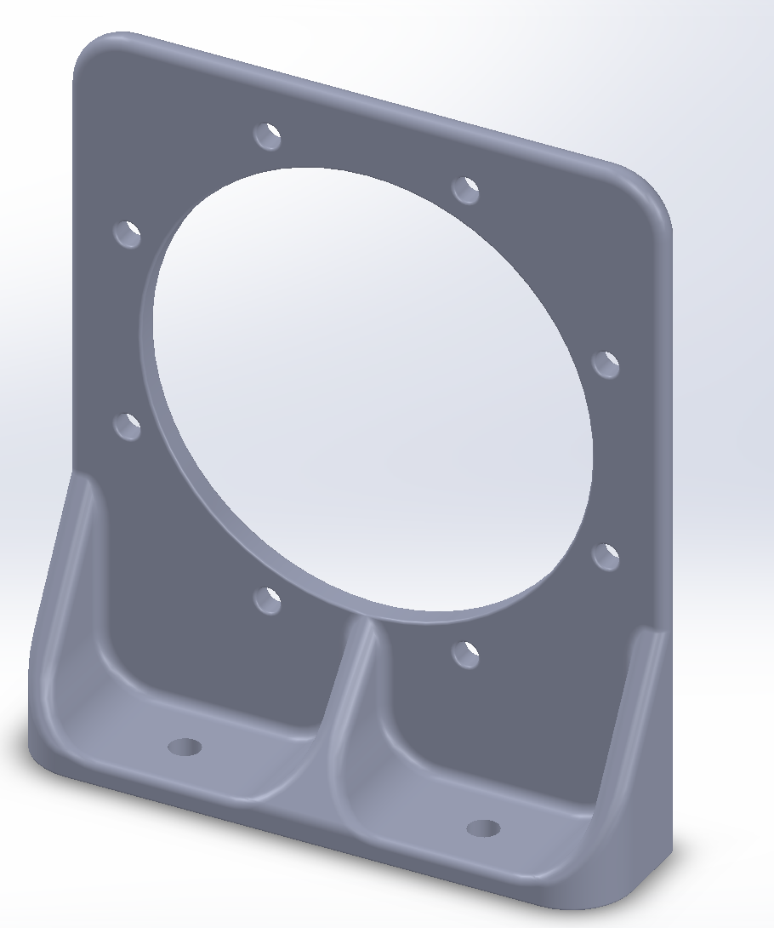
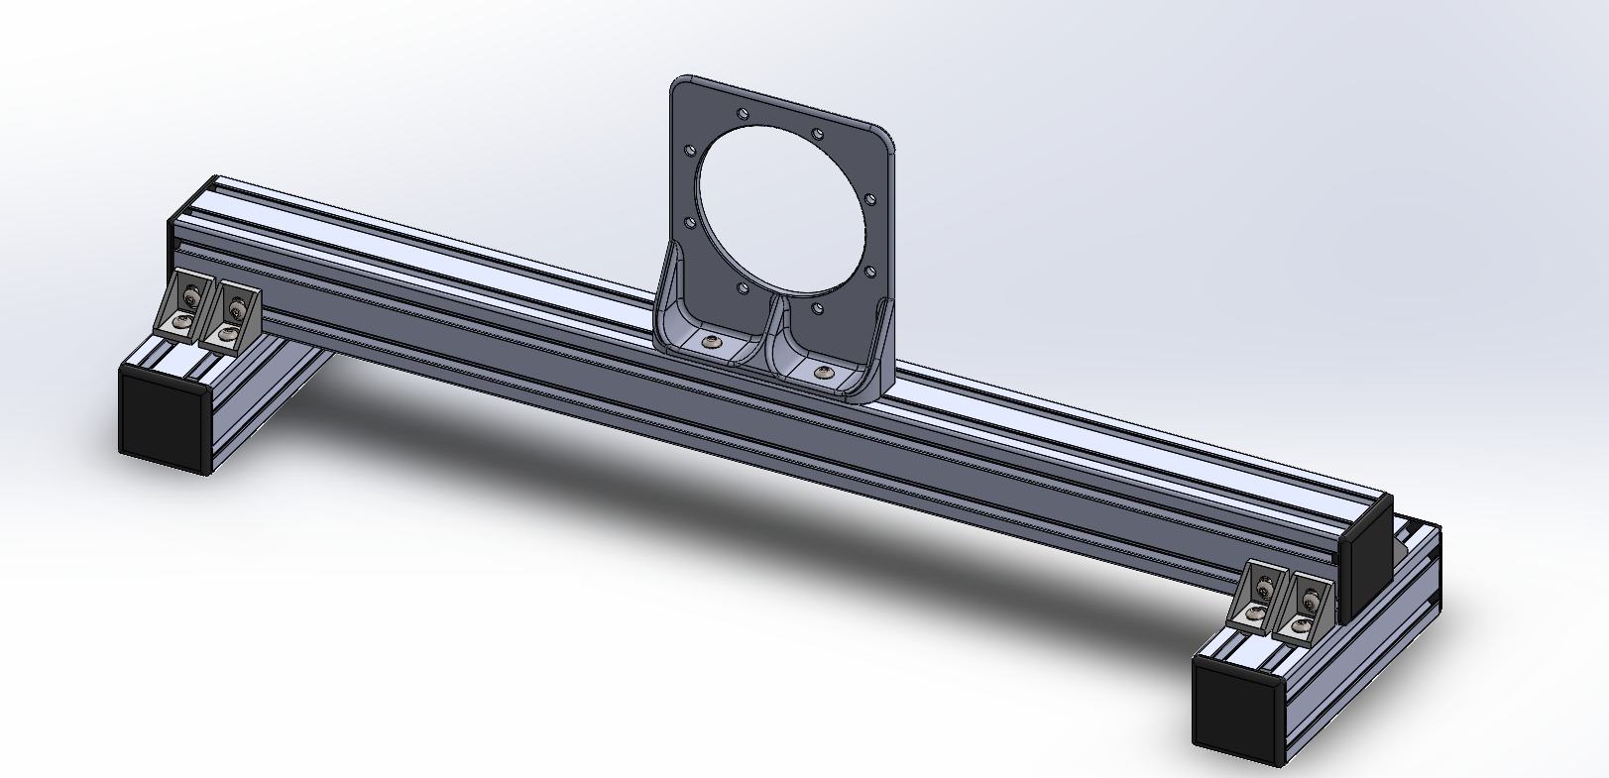
CAD Models: New
Frieden, Mar 1, Exo Actuator 20F09

Slide 8
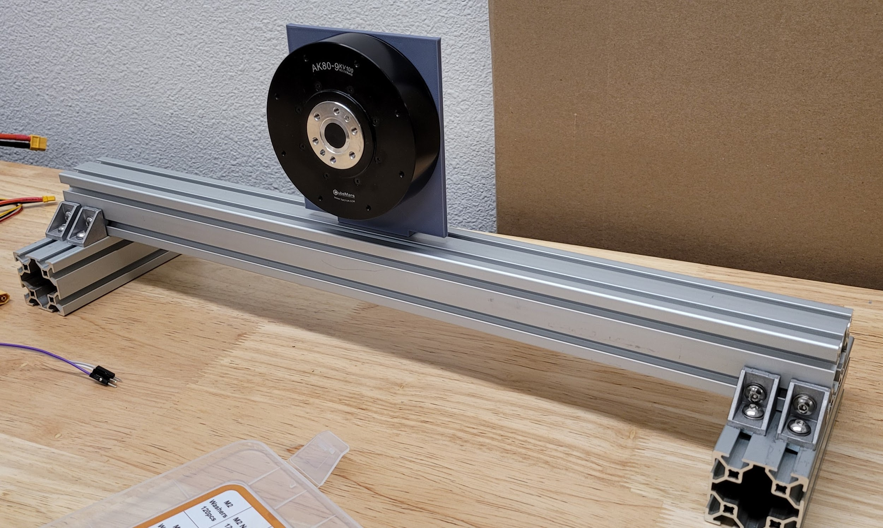
Assembled Frame
Not bolted to the bench
Will use clamps to stabilize during testing
Just printed end caps for the frames for safety
Plenty of space for the wires to be attached
Will be printed in a stronger filament from the ONYX 3d printer
Frieden, Mar 1, Exo Actuator 20F09

Slide 9
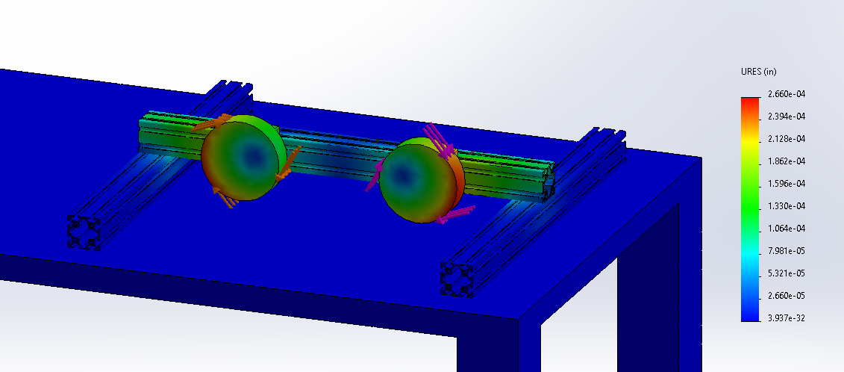
Testing: Solidworks
A simulation was used on the rough solidworks CAD assembly to see if the 80/20 aluminum would be the best option.
The simulation was performed with each motor exerting peak torque of 18 Nm
The maximum deflection was 0.0002660 inches

Slide 10
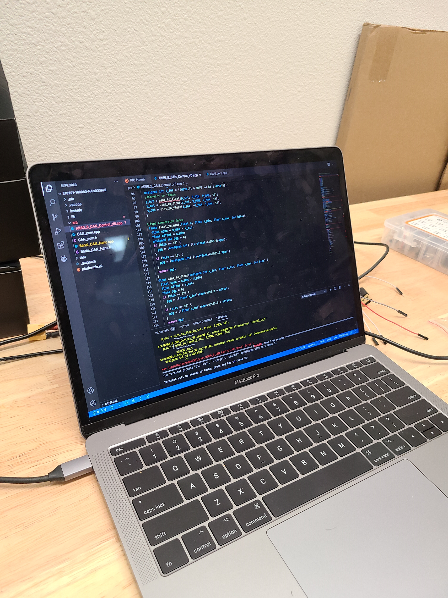
Testing: Code
Confirm expected functionality
Refactor
Create example programs

Slide 11
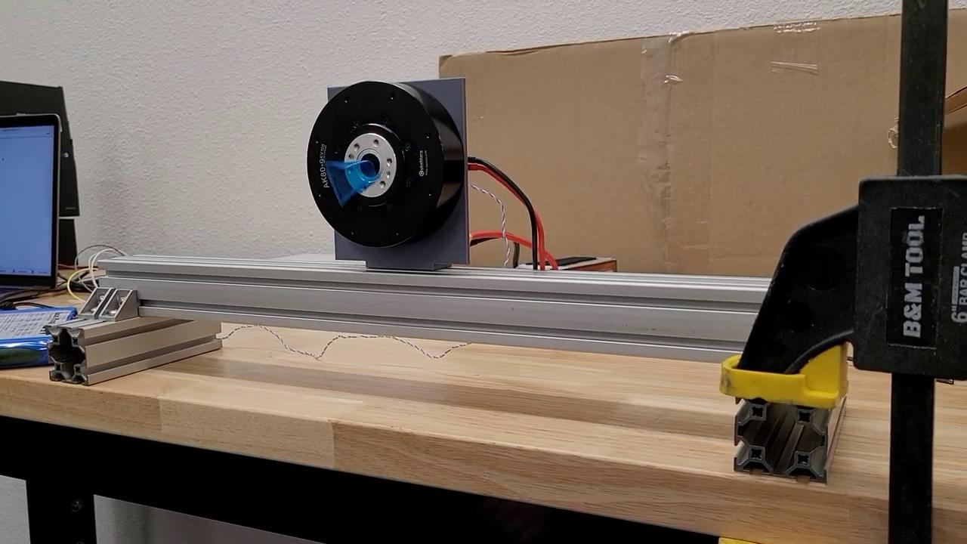
Testing: Motor Video
Velocity control with stiffness
Simple UI
Single Motor

Slide 12
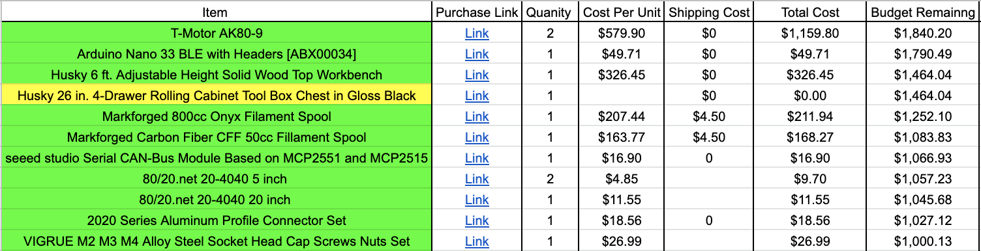
Budget

Slide 13
Future Plans: To do list
Add a simple UI list of commands
Fix the reply functionality of the code
Find a quick order for the battery
Purchase rolling toolbox
Print two revised motor mounts
Design and print two motor arms
Design electric box to house all electronics

Slide 14
Questions?

